Slide 1
23MAT120
S2 Physics/Mathematics

Slide 2
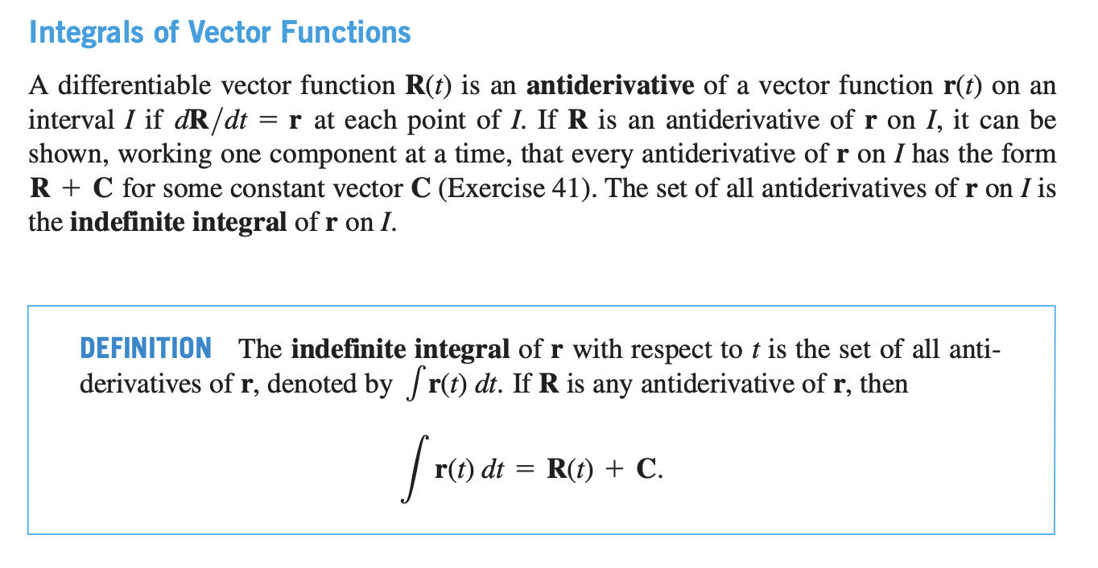

Slide 3


Slide 4


Slide 5

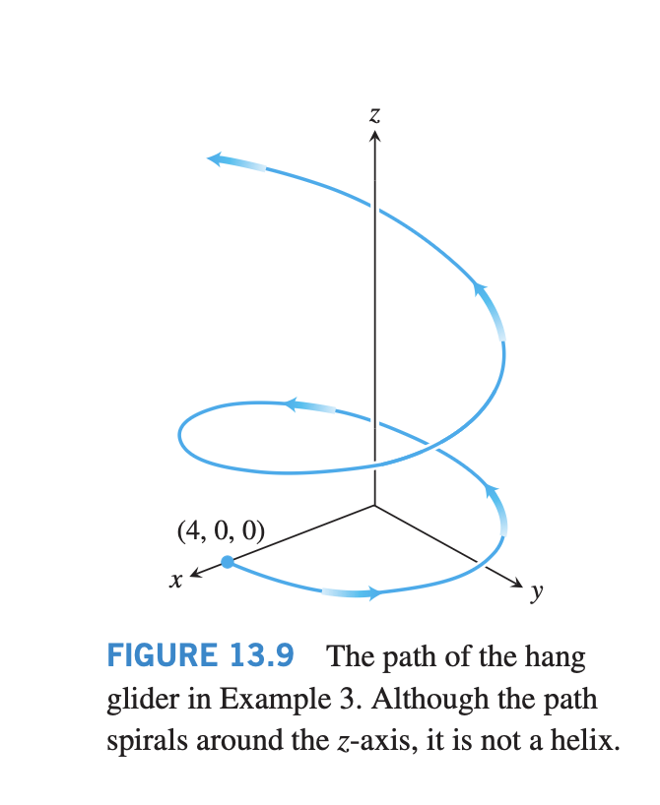

Slide 6
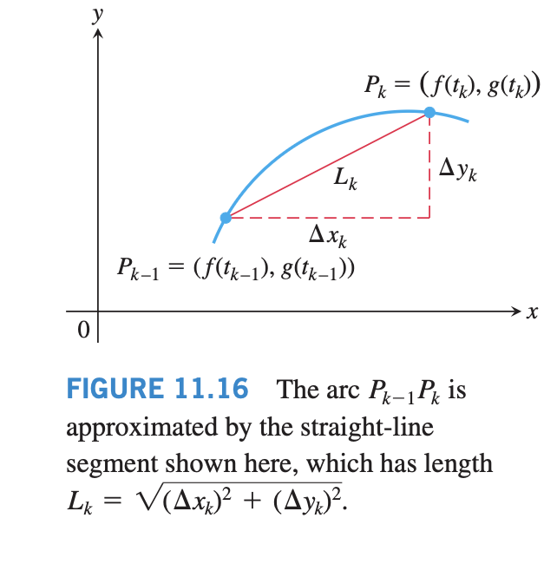




Slide 7



